Slide 1

React JS image and content taken from https://reactjs.org/
R

Slide 2
React Use case
When to Use
When not to use React
Continous User Interaction
State and components frequently changes
Very Complex Structure websites
Simple websites
Landing Pages
Websites contains most of the static contents.
Html generated by backend with very little JS.
Heavy Complex Admin Panel

Slide 3
What is React JS
React is a declarative, efficient, and flexible JavaScript library for building user interfaces.
React is not a framework. It is just a library developed by Facebook to solve some problems that we were facing earlier.
React is built on the concept of Virtual DOM
What is DOM?

Slide 4
What is DOM?
The Document Object Model (DOM) is an application programming interface (API) for HTML and XML documents. It defines the logical structure of documents and the way a document is accessed and manipulated.
The DOM represents the document as nodes and objects.

Slide 5
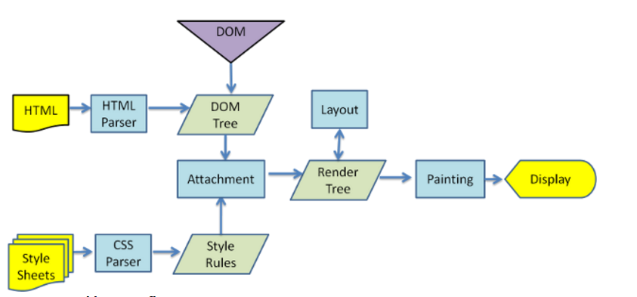
How Browser Works
Reference: https://www.html5rocks.com/en/tutorials/internals/howbrowserswork

Slide 6
Updating a DOM is not slow, it is just like updating any JavaScript object; then what exactly makes updating Real DOM slow?
Rendering engines which is responsible for displaying or rendering the webpage on the browser screen parses the HTML page to create DOM. It also parses the CSS and applies the CSS to the HTML creating a render tree, this process is called as attachment.
Layout process give exact co-ordinates to each node of the render tree, where the node gets painted and displayed.

Slide 7
So when we do,
document.getElementById('elementId').innerHTML = "New Value“
Following thing happens:
  Browser have to parses the HTML
  It removes the child element of elementId
  Updates the DOM with the “New Value”
  Re-calculate the CSS for the parent and child

Slide 8
  Update the layout i.e. each elements exact co-ordinates on the screen
  Traverse the render tree and paint it on the browser display
Recalculating the CSS and changed layouts uses complex algorithm and they effect the performance.
Thus updating a Real DOM does not involves just updating the DOM but, it involves a lot of other process.

Slide 9
Also, each of the above steps runs for each update of the real DOM i.e. if we update the Real DOM 10 times, each of the above step will repeat 10 times. This is why updating Real DOM is slow

Slide 10
How Virtual DOM Solves this problem?
Virtual DOM is in-memory representation of Real DOM. It is lightweight JavaScript object which is copy of Real DOM.
Updating virtual DOM in ReactJS is faster because ReactJS uses
Efficient diff algorithm
Batched update operations
Efficient update of sub tree only
Uses observable instead of dirty checking to detect change

Slide 11
AngularJS uses dirty checking to find the models which has changed. This dirty checking process runs in cycle after a specified time. As the application grows, checking the whole model reduces the performance and thus makes the application slow.
ReactJS uses observable’s to find the modified components. Whenever setState() method is called on any component, ReactJS makes that component dirty and re-renders it.

Slide 12
Whenever setState() method is called, ReactJS creates the whole Virtual DOM from scratch. Creating a whole tree is very fast so it does not affect the performance.
At any given time, ReactJS maintains two virtual DOM, one with the updated state Virtual DOM and other with the previous state Virtual DOM.
** Interview Question ☺

Slide 13
ReactJS using diff algorithm compares both the Virtual DOM to find the minimum number of steps to update the Real DOM.

Slide 14
ReactJS uses following steps to find the difference in both the Virtual DOM’s
Re-render all the children if parent state has changed. If the state of a component has changed, then ReactJS re-renders all the child components even if child components are not modified. To prevent the unwanted re-render of the child components we can use shouldComponentUpdate() component life cycle method. This will further help in boosting the performance.

Slide 15
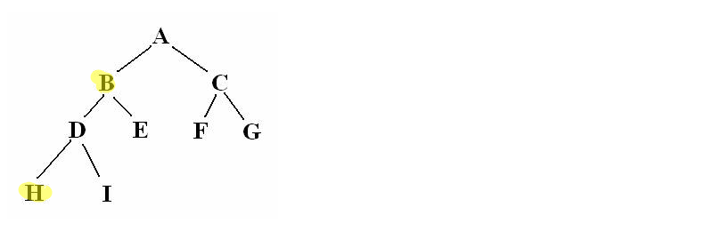
Breadth First Search. ReactJS traverse the tree using BFS. Consider the below tree. States of element B and H have changed. So when using BFS ReactJS reached element B it will by default re-render the element H. This is the reason to use BFS for tree traversal

Slide 16
Reconciliation
When you use React, at a single point in time you can think of the render() function as creating a tree of React elements. On the next state or props update, that render() function will return a different tree of React elements. React then needs to figure out how to efficiently update the UI to match the most recent tree.

Slide 17
React implements a heuristic O(n) algorithm based on two assumptions:
  Two elements of different types will produce different trees.
  The developer can hint at which child elements may be stable across different renders with a key prop.

Slide 18
The Diffing Algorithm
When diffing two trees, React first compares the two root elements. The behavior is different depending on the types of the root elements.

Slide 19
There were multiple ways:-
  Element of different root types
  <div>
  <Counter />
  </div>
  <span>
  <Counter />
  </span>

Slide 20
Whenever the root elements have different types, React will tear down the old tree and build the new tree from scratch.
Going from <a> to <img>, or from <Article> to <Comment>, or from <Button> to <div> - any of those will lead to a full rebuild.

Slide 21
When tearing down a tree, old DOM nodes are destroyed. Component instances receive componentWillUnmount(). When building up a new tree, new DOM nodes are inserted into the DOM. Component instances receive componentWillMount() and then componentDidMount(). Any state associated with the old tree is lost.

Slide 22
DOM Element of Same Type:-
When comparing two React DOM elements of the same type, React looks at the attributes of both, keeps the same underlying DOM node, and only updates the changed attributes. For example:
<div className="before" title="stuff" />
<div className="after" title="stuff" />
By comparing these two elements, React knows to only modify the className on the underlying DOM node.

Slide 23
Component Elements Of The Same Type
https://reactjs.org/docs/reconciliation.html

Slide 24
Batch Update
Batch Update
ReactJS using the diff algorithm to find the minimum number of steps to update the Real DOM. Once it has these steps, it executes all the steps in one event loop without involving the steps to repaint the Real DOM. Thus, if there are more element which gets updated ReactJS will wait for the event loop to finish then, in bulk will updated the real DOM with all the updated elements.

Slide 25
Once all the steps are executed, React will repaint the Real DOM. This means during the event loop, there is exactly one time when the Real DOM is being painted. Thus all the layout process will run only on time for updating the real DOM.

Slide 26
ES6 Features

Slide 27
String Interpolation
Destructring
Spread
Classes
  class Car {
  constructor(name){
  this.brand = name;
  }
  }
  https://www.w3schools.com/REACT/react_es6.asp

Slide 28
Different ways of Creating React App
Using Webpack and babel:-
  Install Node
  https://www.freecodecamp.org/news/part-1-react-app-from-scratch-using-webpack-4-562b1d231e75/
  npm install --save-dev @babel/core @babel/preset-env @babel/preset-react

